Slide 1
CSE7302- University Project Review-5
SIH25231 - RURALMED NEXUS: AN OFFLINE INTELLIGENT MEDICAL KNOWLEDGE SYSTEM
Batch Number: ISE 28
Roll Number 20221ISE0053
20221ISE0083
20221ISE0084
Student Name Mohamed Aslam Pasha Kovuri Nizamuddin Vaseem B M
Under the Supervision of,
Mr. Santhosh Kumar K L
Assistant Professor
School of Computer Science and Engineering Presidency University
Name of the Program: B.Tech
Name of the HoD: Dr. Gopal Shyam
Name of the School Project Coordinators: Ms. Sumita Guddin

Slide 2
Content
Problem Statement
Objectives
Analysis of Problem Statement(Software Requirements)
Analysis of Problem Statement(Hardware Requirements)
Innovation or Novel Contributions
Flow Diagram
Literature Survey

Slide 3
Problem Statement :
Organization: Smart Automation
Category : Software
Problem Description: With the rapid growth of unstructured and multimodal data, organizations increasingly rely on documents, scanned images, and voice recordings to store critical information. However, existing information retrieval and question-answering systems are largely text-centric and cloud-dependent, making them unsuitable for offline, secure, or resource-constrained environments such as defense systems, healthcare facilities, research labs, and remote locations.
Traditional search systems struggle to understand semantic meaning across multiple data formats like DOC files, PDFs, images, and audio recordings. They often require separate processing pipelines for each modality and lack a unified framework for cross-modal retrieval. Moreover, most modern Large Language Model (LLM)–based solutions depend heavily on internet connectivity and external APIs, raising concerns related to data privacy, latency, regulatory compliance, and operational continuity.

Slide 4
Objectives :
1. Develop an Offline-Capable RAG Architecture
Design a complete RAG pipeline that functions entirely in offline mode, eliminating dependency on cloud services or external APIs.
Enable Multimodal Data Ingestion
Implement robust ingestion mechanisms for multiple data formats including text documents (DOC, PDF), images, and audio recordings.
Create a Unified Semantic Embedding Framework
Convert all modalities into a common vector embedding space using modality-specific encoders.
4.Design an Efficient Offline Indexing and Retrieval Mechanism
Implement a local vector database or similarity search index to store multimodal embeddings.

Slide 5
Objectives :
Integrate an Offline Large Language Model
Deploy a lightweight or optimized local LLM capable of understanding retrieved context and generating meaningful responses.
Support Context-Aware Question Answering
Enable users to query the system using natural language and receive contextually accurate, explainable responses grounded in retrieved documents.
Ensure Data Privacy and Security
Maintain complete data sovereignty by keeping all documents, embeddings, and inference processes local.
Provide a Scalable and Extensible System Design
Design the architecture to support future expansion to additional data formats and models.

Slide 6
Analysis of Problem Statement ( Software Requirements )
1 Frontend
HTML
CSS
JavaScript
2 Backend
Python with Flask
3 AI/ML Model
Natural Language Processing(NLP): Python
4 Database
SQL
5 Development Tools:
Tools like VS Code, Git
Testing and Debugging: Web Browser ( Chrome, Firefox, Edge )
Python (with libraries and frameworks)

Slide 7
Analysis of Problem Statement ( Hardware Requirements )
1 Development Machine
Processor: A modern multi-core processor(64-bit Processor (Intel i5/i7 or AMD Ryzen 5/7))
RAM: At least 8 GB
Storage: 30GB recommended
2 Network:
Internet Connection: Stable and standard speed internet connection for development and deployement
3 Additional Hardware (Optional for Deployment)
Microphone for voice data ingestion
External Storage (HDD/SSD) for large offline datasets
High-resolution Scanner for document digitization

Slide 8
Innovation or Novel Contributions
Fully Offline Multimodal RAG Architecture:
Unlike most RAG systems that rely on cloud-based APIs, this project delivers a completely offline Retrieval- Augmented Generation framework, enabling secure operation in air-gapped and privacy-critical environments
Unified Semantic Retrieval Across Multiple Modalities:
Text documents (DOC, PDF), images, and voice recordings are transformed into a shared semantic embedding space, allowing seamless cross-modal retrieval using a single query interface.
End-to-End Multimodal Ingestion Pipeline:
The system integrates document parsing, OCR, and speech-to-text into a single automated ingestion workflow, eliminating the need for separate tools for each data format.
4. Local LLM Integration for Context-Aware Generation:
A locally hosted LLM is tightly coupled with the retrieval engine to generate responses strictly grounded in retrieved evidence, minimizing hallucinations while preserving data privacy.

Slide 9
Innovation or Novel Contributions
Offline Vector Indexing and Search Optimization:
The project implements an efficient on-device vector indexing mechanism, optimized for low-latency semantic search without relying on external vector databases or internet connectivity.
Privacy-Preserving Knowledge Discovery:
All data processing, embedding generation, storage, and inference occur locally, ensuring complete data sovereignty and compliance with strict security and regulatory requirements.
Extensible and Modular System Design:
The architecture is designed to be model-agnostic and format-agnostic, allowing future integration of additional data modalities (e.g., video) or upgraded LLMs without major redesign.
Cross-Modal Query Capability:
Users can issue natural language queries and retrieve relevant information regardless of the original data format, enabling text-to-image, text-to-audio, and document-to-document semantic search.

Slide 10
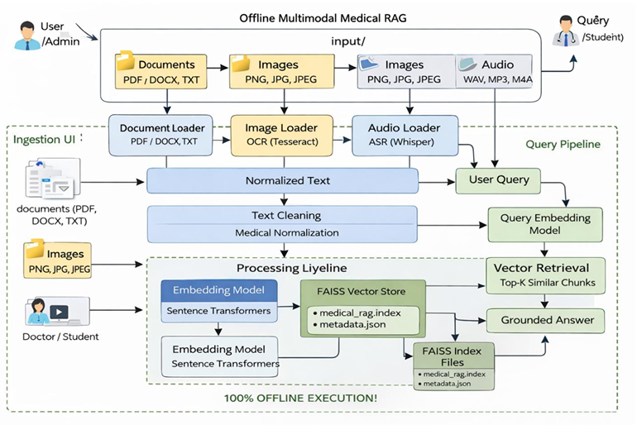
Flow Diagram

Slide 11
Literature Survey
Click Here

Slide 12
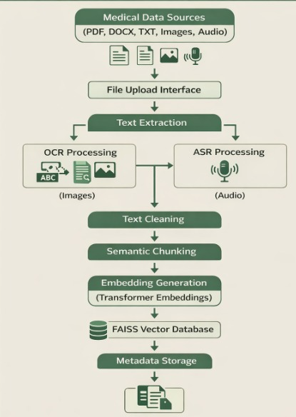
Ingestion Pipeline

Slide 13
Ingestion Pipeline
Multisource Data Ingestion The pipeline collects medical data from various formats such as PDF, DOCX, TXT, images, and audio through a dynamic file upload interface.
Text Extraction with OCR & ASR OCR converts image-based medical content into text, and ASR converts audio into text, enabling multimodal data processing.
Text Cleaning Extracted text is cleaned by removing noise, duplicates, and formatting issues to improve accuracy for further processing.
Semantic Chunking Cleaned text is split into smaller meaningful chunks to preserve context and improve efficient retrieval of relevant information.
Embedding Generation & Storage (FAISS) Each chunk is converted into vector embeddings using transformer models and stored in a FAISS vector database for fast similarity search.
Metadata Storage for Traceability Metadata like source, document reference, and chunk details are stored to ensure transparency, reliability, and traceability—critical for healthcare applications.

Slide 14
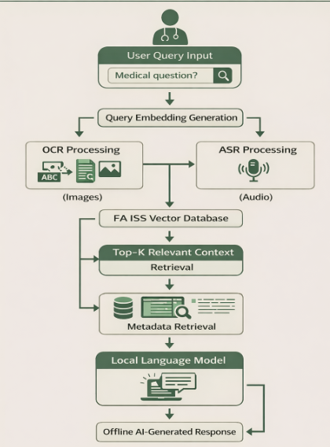
Query Pipeline

Slide 15
Query Pipeline
User Query Input The process begins when a user submits a medical question through the system interface.
Query Embedding Generation The input query is converted into an embedding using the same model used during data ingestion.
Similarity Search in FAISS The query embedding is compared with stored embeddings in the FAISS vector database to find related medical information.
Top-K Relevant Context Retrieval The system retrieves the most relevant document chunks (Top-K) based on semantic similarity to the query.
Metadata Retrieval for Traceability Source information and document references are identified to ensure transparency and reliability of retrieved data.
Response Generation using Local Language Model The local model uses the retrieved context and metadata to generate an accurate, offline AI-based medical response.

Slide 16
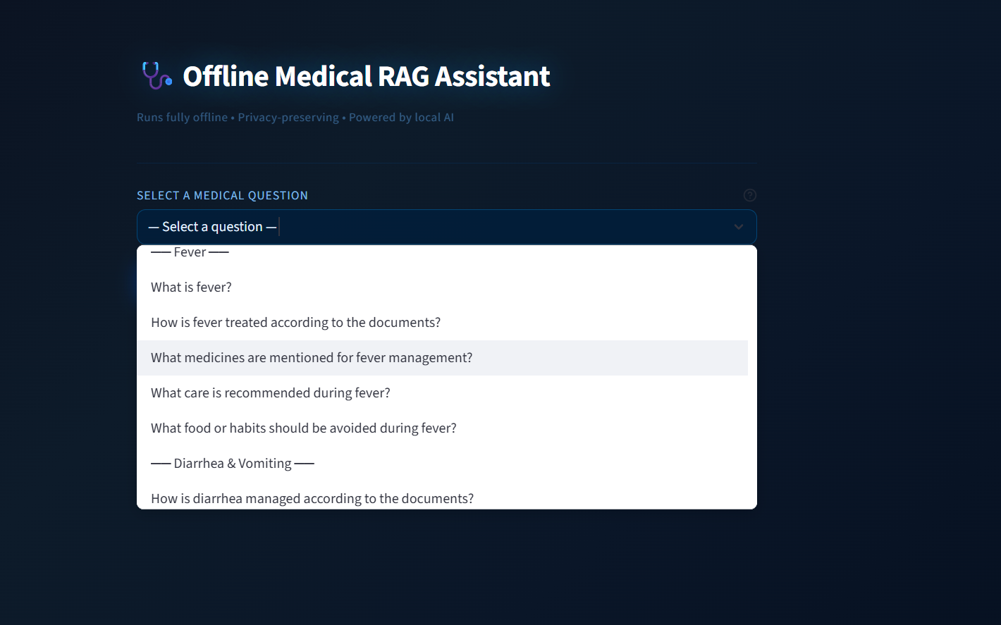
Enhancement

Slide 17
Enhancement
User-Friendly Query Interface The system provides a simple interface with predefined medical questions, making it easy for users without technical knowledge.
Dropdown-Based Selection Users can select categories like symptoms, which then display related diseases (e.g., fever, seasonal illnesses).
Guided Navigation The design helps users quickly find relevant questions, improving usability—especially for rural users.
Context-Based Response Generation Responses are generated based on the existing medical knowledge base, ensuring relevance and reliability.
Embedding & FAISS Retrieval Process Selected queries are processed through embedding generation and matched with the FAISS vector database to retrieve relevant information.
Improved Accessibility & Accuracy The approach reduces input errors and provides timely, accurate answers, enhancing accessibility for rural healthcare users.

Slide 18
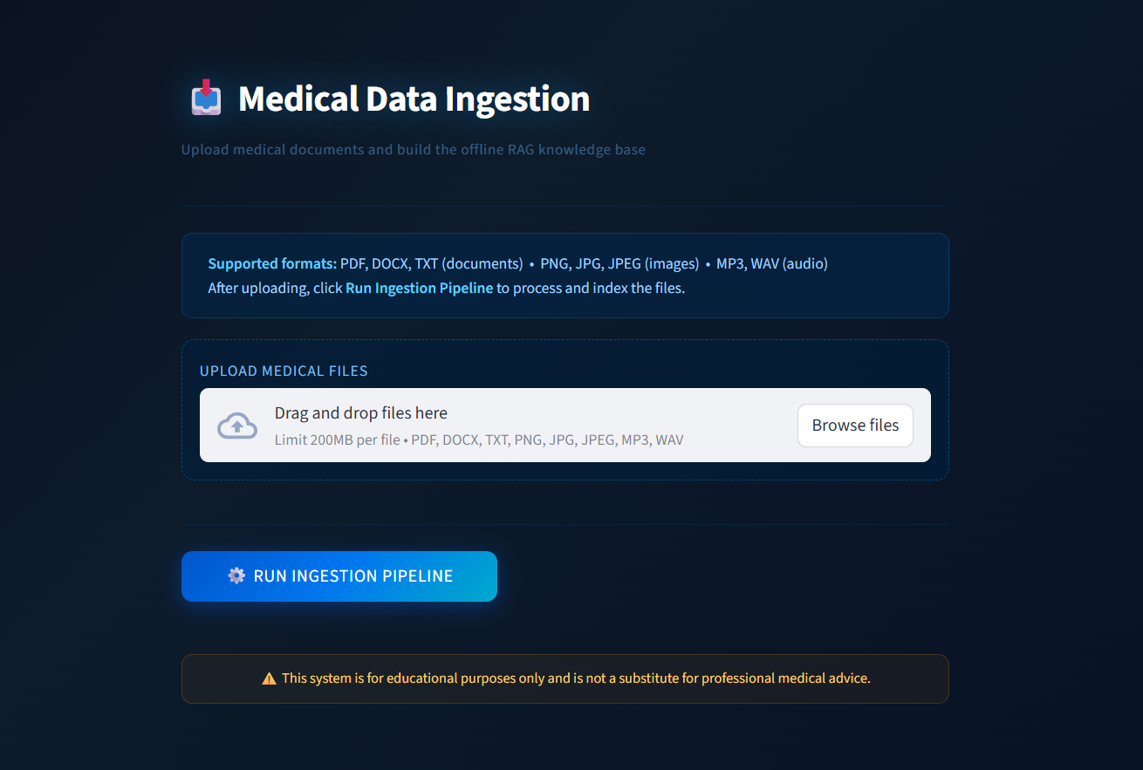
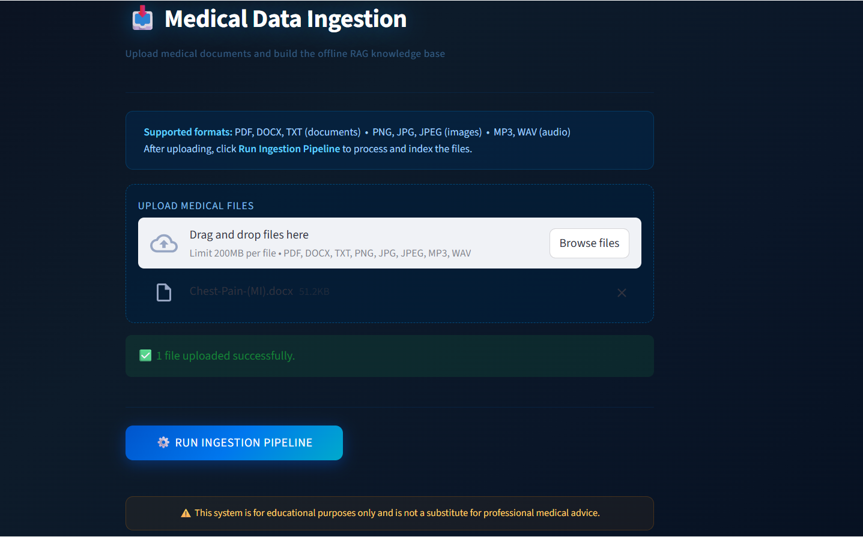
Results

Slide 19
Appendix
GITHUB :
https://github.com/aslamaslam1842004/ISE-28-rural-med-nexus-an-offline-intelligent-medical-knowledge-system

Slide 20


